Slide 1
Marketing Analytics- Customer Behavior Analysis
Project 3

Slide 2
agenda
INTRODUCTION 4
INSIGHTS 4
RECCOMENDATIONS 11
RECCOMENDATIONS 12
CONCLUSION 13

Slide 3

Introduction
Customer behavior analysis seeks to understand the behavior of customers to predict customers deciding to stop using the product which is churn.
Businesses need to analyse customer turnover since it is critical to maintaining income, increasing customer lifetime value, and gaining a competitive advantage in the marketplace. It gives decision-makers a data-driven basis, enabling them to optimise their product offers, enhance consumer happiness, and adjust their marketing tactics.
By looking at the data with all the variables aka behaviours we can find value in comparing it with churn and seeing if there are any possible correlations.

Slide 4
INSIGHTS

Slide 5
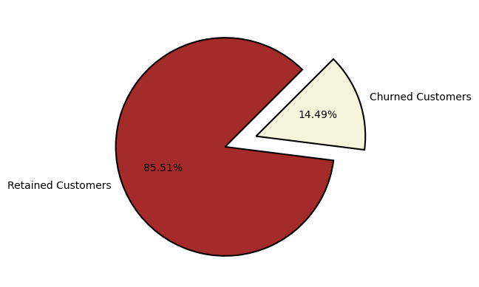
Churn rate of Customers
the pie chart shows the percentage of churned customers with 14.49% being churned and 85.51% retained

Slide 6
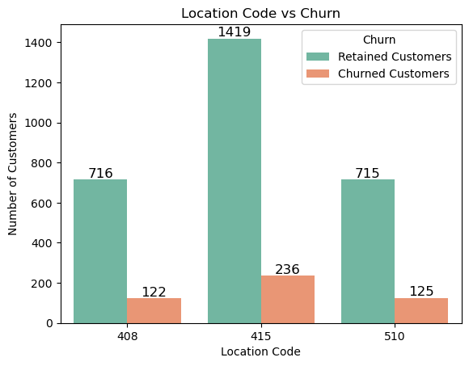
Location Code vs Churn
From this, we can say that location code 415 has majority of customers

Slide 7
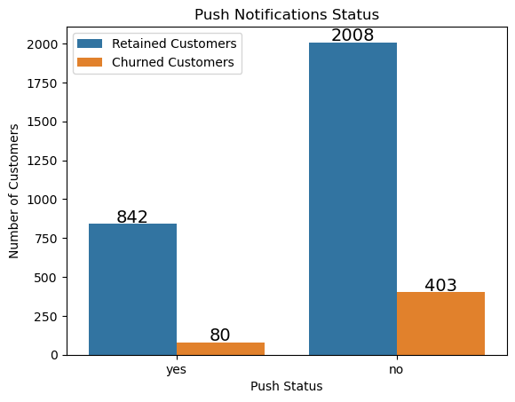
Push Notification Status
From this, we can say that the majority of customers do not allow push notifications

Slide 8
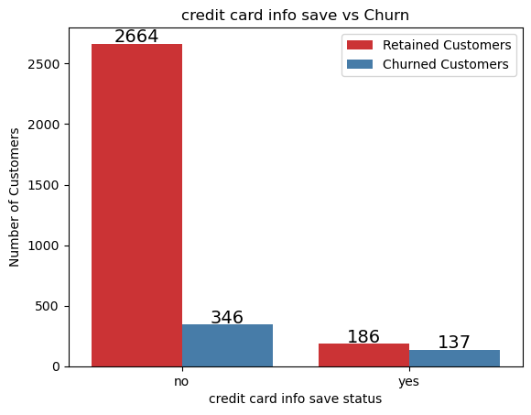
Credit card info save vs Churn
Customers who have their credit card information stored are much less likely to churn than those who do not.

Slide 9
Reccomendations
Irrelevant Content
Push Notification
Bad Timing
Users may become disengaged from push notifications if they don't relate to their interests or behavior.
Users may view the app as unhelpful and opt to quit using it if they receive notifications that do not correspond with their preferences or prior interactions with it.
Overwhelming Frequency: It might be bothersome and invasive to inundate users with push notifications. To lessen the disruption in their everyday life, users may decide to remove the app or stop push notifications if they are overloaded or irritated by the continuous messages.
Push notifications that are sent at odd hours, like late at night or during the workday, can be annoying and cause users to leave the app or leave poor reviews.
Such notifications could be perceived by users as an infringement on their privacy or daily schedules.

Slide 10
Recommendation
Clickbait or Deceitful alerts
Clickbait or deceitful alerts can get users to launch an application, but they may leave disappointed if the content within falls short of their expectations. Such strategies can cause churn and undermine confidence.
Consumers that have activated push status are less likely to churn, therefore encouraging consumers to do so could help reduce churns.
Compared to clients without their credit card information saved, those who have it saved on the side are much less likely to experience turnover. This implies that churns may be reduced if the store encourages customers to save their credit card information.
. This makes sense because consumers who are confident in the brand are also confident about their credit card information. Greater trust decreases the likelihood of clients quitting your company.

Slide 11

Conclusion
Through Customer behavior analysis businesses can predict and prevent customer churn by identifying the customer who are more likely to churn and implement prevention strategies to retain the customer.

Slide 12
thank you

